Slide 1
Failure of RMS Titanic
Identifying Systematic Biases that led to the project failure
Presented by: Team 4
Amy Siedlecki
Sriram Rajagopalan
Rikdev Bhattacharya
Sriraman Srinivasan
Chen-wei Huang

Slide 2
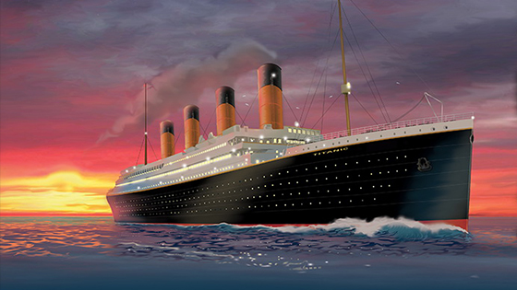
Agenda
Background of the RMS Titanic
Definition of Scope
Key Stakeholder Introduction and Analysis
Facts of the Failure
Systematic Bias Definition
Connecting the Failure to the Systematic Bias
Mitigation and Recommendations
Conclusion
Questions and Answers

Slide 3
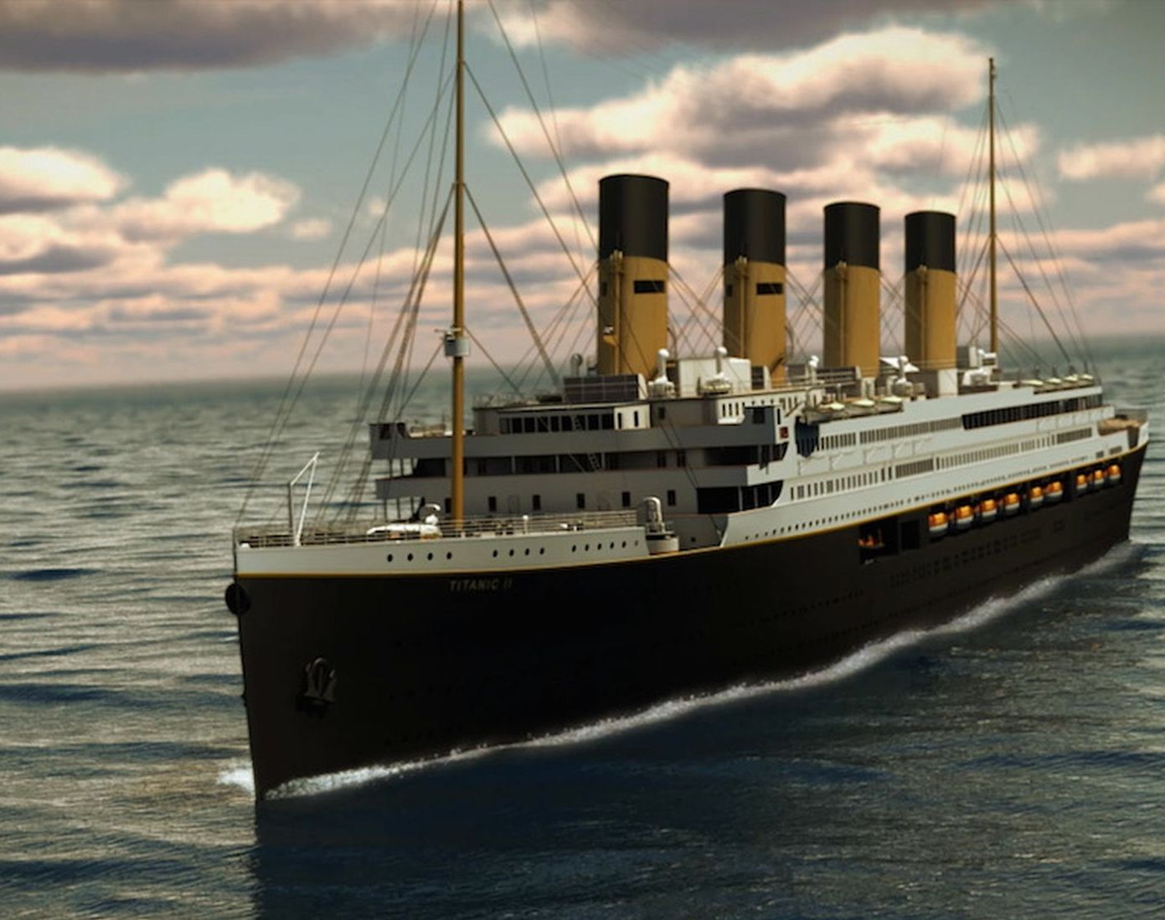
Introduction to RMS Titanic
As one of three sister ships, Titanic was the largest ship on the water of her time
Most luxurious ship to be built in 1912 and had the best architecture seen on the sea
Began its maiden voyage to New York on April 10, 1912, from Southampton, England
Length: 883 feet
Weight: 52,310 tons
Construction started: 31st March1909
Place built: Belfast, Ireland
Designer: Thomas Andrews
First Class Ticket Price: $4,375
Max Number of Passengers: 3,547
# of passengers aboard: 2,223
#of couples on honeymoon: 13
Cost: $7.5 million
Notes:
Question to class: Guess how much that costs today for first class ticket price.?

Slide 4
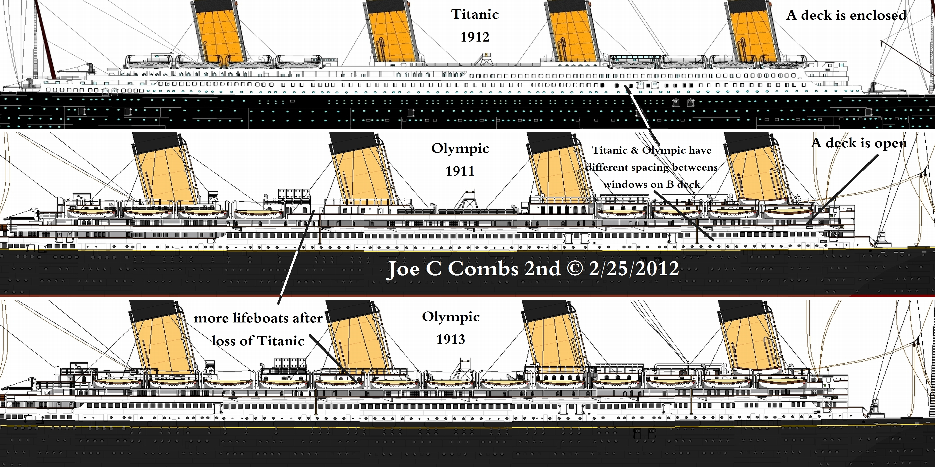
Definition of Project Scope
Building 3 ships over 7 years
75% of revenue was planned to come from first-class passengers
Technology, safety, and luxury were the key drivers
Speed was an initial tradeoff
Speed vs. Luxury and Safety became Safety vs. Luxury and Speed
“Practically unsinkable”
The impact of tradeoffs were not analyzed appropriately
Flawed ‘Lessons’ from the RMS Olympic (which had been badly damaged in a collision) were used to modify Titanic’s design

Slide 5
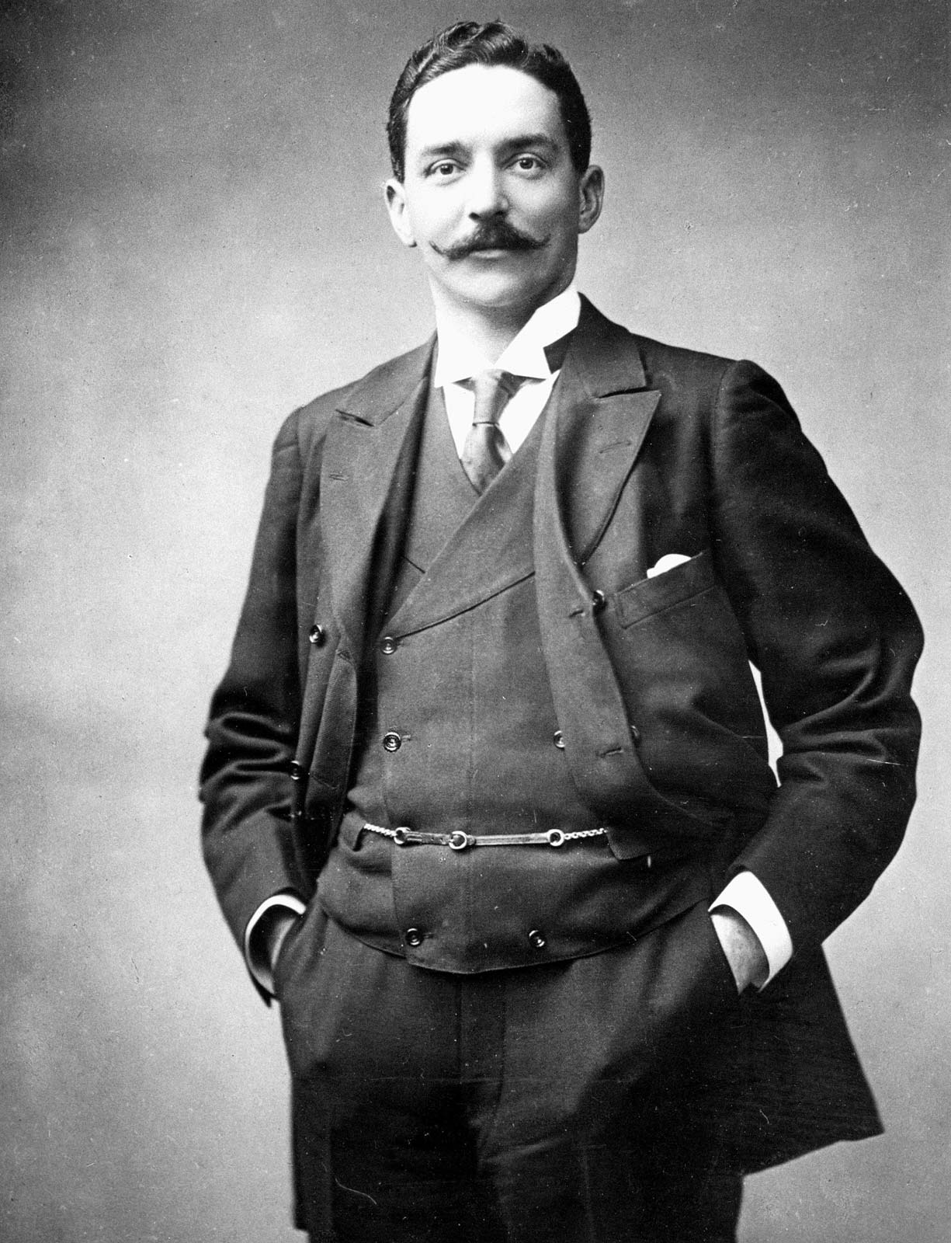
Stakeholder Analysis
The two stakeholders made decisions which led to the tragedy of titanic
Bruce Ismay, White Star Chairman
Consistently changed scope without analyzing the impact
Scope changed from Speed vs. Luxury and Safety to Safety vs. Luxury and Speed
Edward Smith, the captain of RMS titanic
Captain Smith was very respected in the maritime community with an outstanding track record
More than four decades of sailing experience
Bruce Ismay

Slide 6
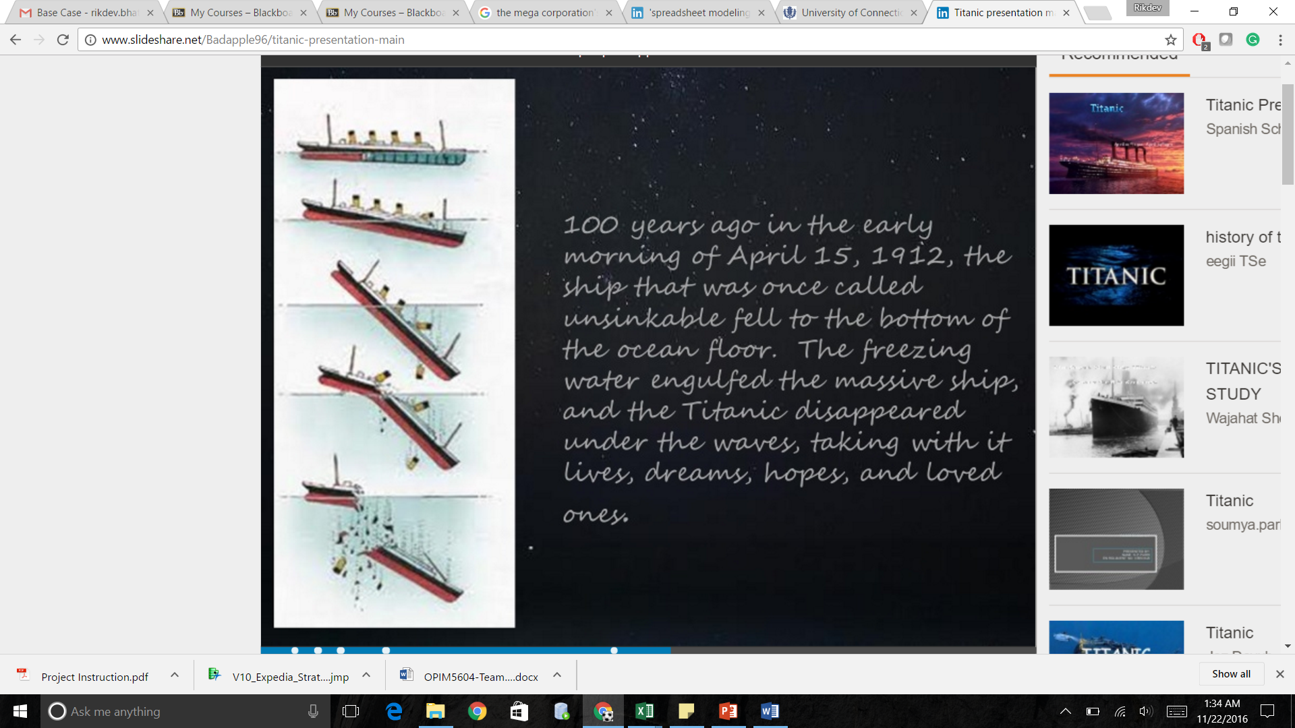
Facts of Failure
Hit an iceberg at around 23:40 PM on April 14th, 1912
Sank at 02:20 AM two hours and forty minutes later
RMS Titanic had 2,228 persons aboard
1,517 fatalities
World’s biggest peacetime maritime disaster at that time

Slide 7
Systematic Bias: Overconfidence
Definition: Individuals tend to be overconfident of the infallibility of their judgments when answering moderately to extremely difficult questions
Psychological bias
Overestimation of one’s actual ability, performance, level of control, or chance of success
People are more sure that they are correct than they should be
1. Lack of testing and training before maiden voyage
2. Inadequacy of design of bulkheads
3. Poor decision making during maiden voyage
4. Decision to remove lifeboats

Slide 8
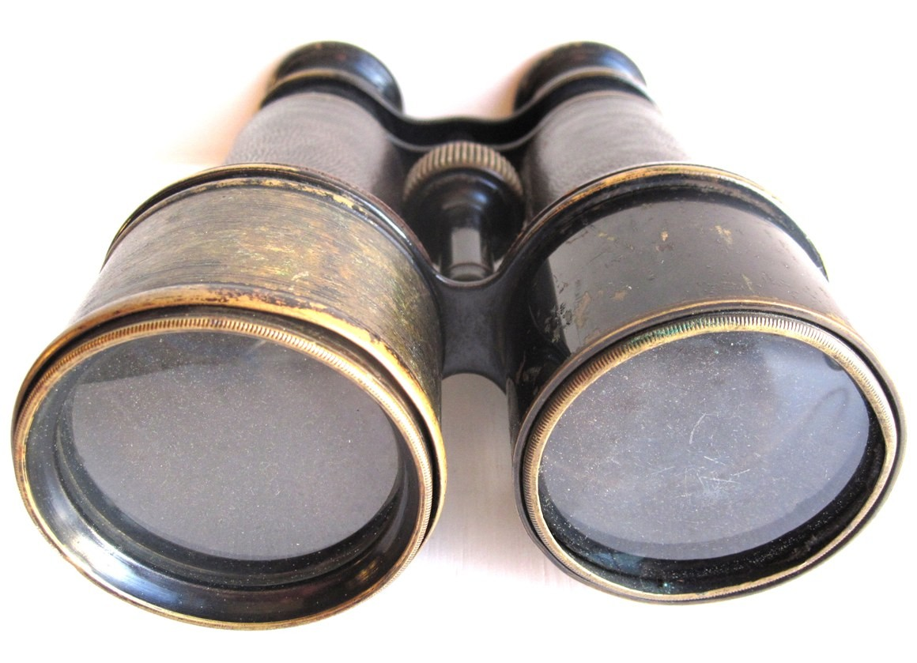
Evidence 1: Lack of Testing and Training Before Voyage
Key stakeholders decided to forgo normal testing of the ship since it was behind schedule
Sea tests were reduced from 30 days to a half day
Crew was unprepared to manage the ship
No proper training was given in advance
No mock drills conducted prior to the journey leading to increased loss of life
Notes:
Notes:
Mention binoculars were locked up.
The ship's owners, the White Star Line, boasted of the size and stamina of the largest passenger steamship built until that time.
Lifeboat drill was scheduled to take place on board the ship the very day the Titanic hit the iceberg, but was canceled by the captain.
The impact with which the boat hit the iceberg popped heads off rivets, opening gashes in the hull.
Rivets made of iron that were not of the highest quality, and were not uniformly inserted, were used in the forward hull.
There was Charpy Impact Test conducted on a specimen of the hull steel of titanic to find out the brittleness of it

Slide 9
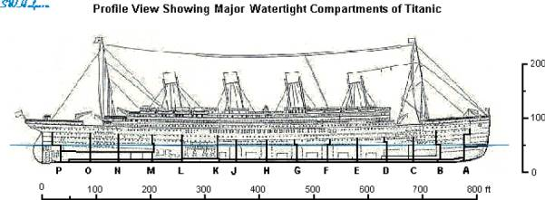
Evidence 2: Construction of the Bulkheads
Bulkheads of a ship separate the hull into individual watertight compartments so that if there is damage the water will not flood the entire ship
The RMS Titanic team exhibited overconfidence in two decisions related to the construction of the bulkheads
In order to provide a grander ballroom, they reduced the height of some of the walls of the bulkheads limiting their effectiveness
They built the ship with the assumption that only one bulkhead would be damaged at a time and were not prepared for more substantial damage

Slide 10
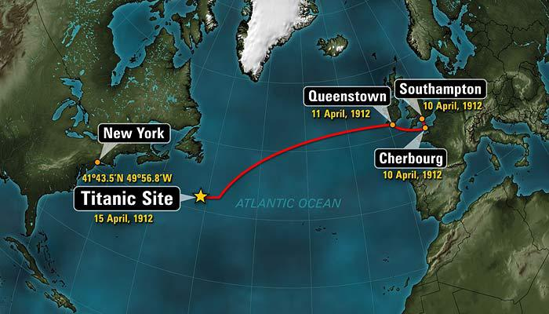
Decision Making During Maiden Voyage
Captain Smith’s actions driven by Ismay’s decisions to maintain the current speed and heading, and leave the bridge at a crucial time, are all the result of overconfidence bias based on his past experience and success.
Smith instructed the ship to sail at near full speed knowing that the area was full of icebergs

Slide 11
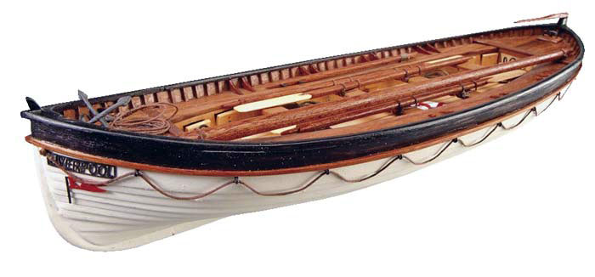
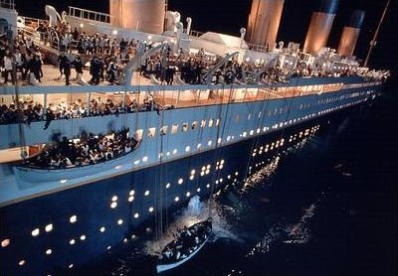
Lifeboats
Lifeboats were reduced to provide a better view for first class passengers
Original Plan: 64 Lifeboats
During Voyage: 20 Lifeboats (Sufficient only for 53% of the passengers)
“The Chief Designer, Carlisle resigned over the lifeboat issue, but his concerns were steadfastly ignored by the stakeholders.”
The crew was unprepared for a disaster and did not know how to load the life boats
Many lifeboats left the sinking ship less than full
Notes:
Standard Regulation : 16 Lifeboats for ships above 10 K Tons

Slide 12

Mitigations and Recommendations
Redistribute power: Bruce Ismay made all the decisions with little consideration of potential downfalls
Improve change control process including analyses of the potential impact of all individual changes as well as the impact of the combination of changes
Filter Information Flow and Improve Communication
Reduce the influence of external pressures
Notes:
Hiring a respected and influential project manager who could help Ismay understand the impact of his decisions and dissuade him from negatively impacting the construction of the ship
Change control process would be driven by the project manager but informed by a committee with subject matter experts from all the potentially impacted teams
Ensure that the decision makers (Ismay) have all of the relevant information
Media’s perception led to overconfidence

Slide 13
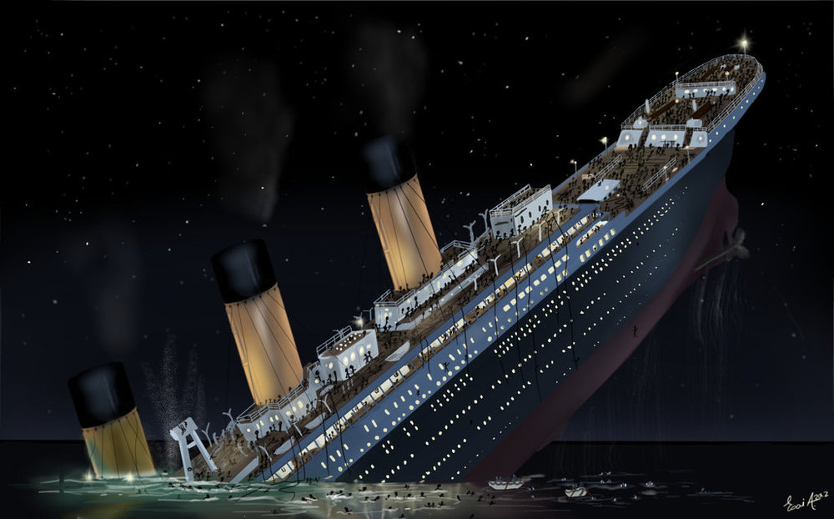
Conclusion
Due to overconfidence of the stakeholders and the majority of the project team, safety was consistently traded off in exchange for further luxury of the ship
Improperly constructed bulkheads to create a grander ballroom
Fewer lifeboats to provide a better view for 1st class passengers
Lack of testing of the ship and training of the crew
Poor decision making during the maiden voyage
Through redistribution of power, improved change control process, improved communication, and the reduction of external pressures, the failure of the RMS Titanic could have been avoided.

Slide 14
Questions?

Slide 15
References
http://www.titanicfacts.net/
https://en.wikipedia.org/wiki/RMS_Titanic
http://channel.nationalgeographic.com/titanic-100-years/
https://www.apm.org.uk/news/titanic-lesson-in-project-management/
http://cosmiclog.nbcnews.com/_news/2012/04/01/10970732-10-causes-of-the-titanic-tragedy
http://www.maxwideman.com/guests/meddling/scope.htm
http://www.historyinanhour.com/2012/10/17/j-bruce-ismay-summary/
http://www.williammurdoch.net/man-07_decision_in_retrospect.html
http://www.techrepublic.com/blog/10-things/10-project-management-lessons-from-the-titanic-disaster/

